Slide 1
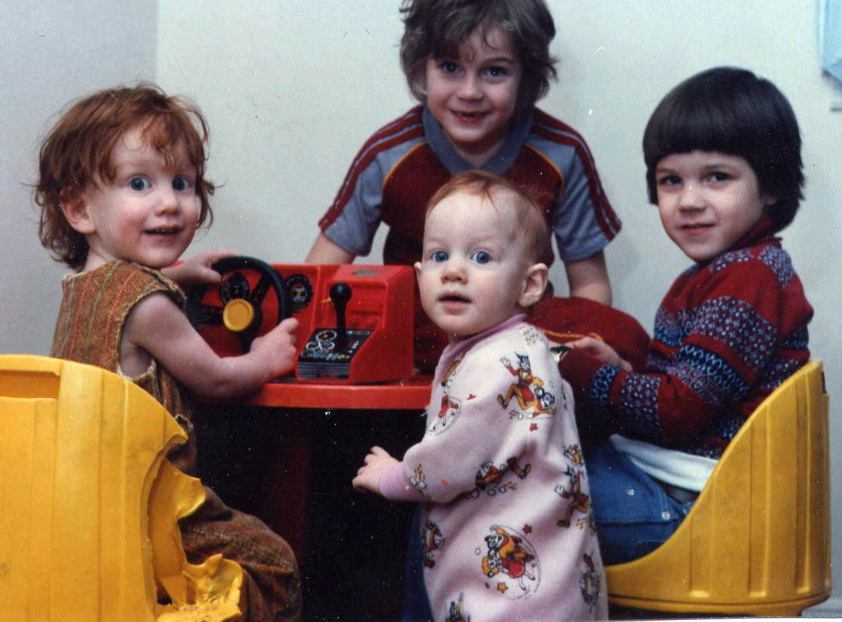

SOCIAL DEVELOPMENT

Slide 2
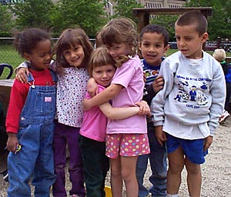
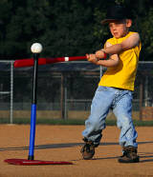

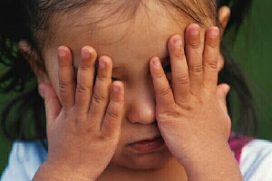
4 Areas of Development...
Human beings develop in 4 different aspects of growth. The areas are all inter-connected, so when one is affected it may influence the others.
Social
Physical
Intellectual
Social development is the process of learning to relate to other people.
Emotional

Slide 3

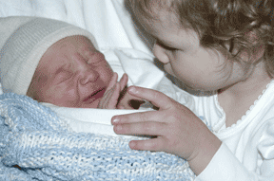
Early relationships...
The child’s first relationships are the foundation for social and emotional development. Shortly after birth the child will recognize and prefer the voice of the parent over anyone else. At just about 6 weeks the child comes to know the parent, their smell and face and the way they hold the baby, etc.
A sibling relationship can be important at this time as well, as long as a rivalry for the parent’s attention is not cultivated.
When these first relationships are positive, children develop confidence in themselves, trusting relationships with others, and a hopeful outlook on life.

Slide 4
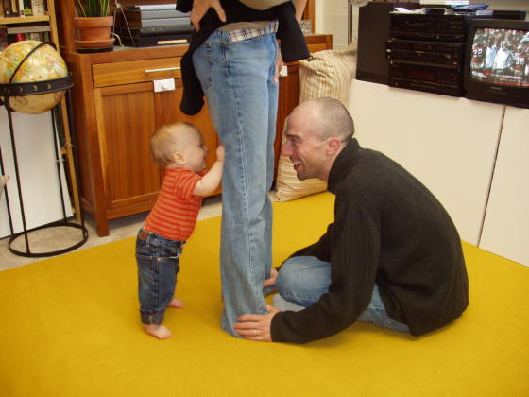
Social anxiety...
By the age of 6 months, the child should visibly demonstrate an attachment to the primary caregiver. This in turn may lead to stranger anxiety by the age of 8 months to 2 years. The child may fuss and cry when left in the care of a stranger.
To make this time of “stranger” or “separation” anxiety a little easier for the parent, they may try the following steps. Leave with a hug, a kiss and a wave goodbye. Then leave promptly. Never sneak away. This only makes the situation more difficult. Encourage the child to take something like a favorite toy or blanket with them.
By the age of 9 months to 2 years, the child may suffer from separation anxiety. They have not yet learned that “objects and people continue to exist even when they can’t be seen”. The game of peek-a-boo teaches this concept.
These forms of anxiety combine social and emotional development.

Slide 5
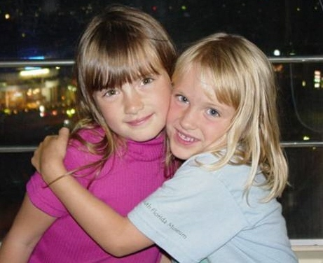
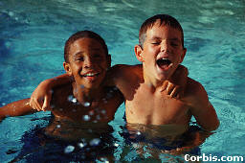
Homosocial
behavior...
“Yuk! I hate boys! They’re mean and dirty.”
“Girls smell funny; girls can’t play baseball; go away!”
During childhood, human beings display behavior that may be described as homosocial. They show a distinct preference for associating with the same sex. Girls like girls and boys like boys. This is not sexual behavior. It is a normal pattern of social development that should not be confused with suggestions to children that they should have a “boyfriend” or “girlfriend”.

Slide 6
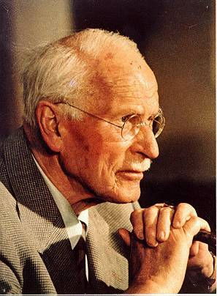
Temperament / personality...
Temperament is an unlearned tendency to experience things in a certain way. Your persona (personality) is the mask you put on before you show yourself to the outside world…the impression you give to others, which may or may not be a reflection of your true temperament. Carl Jung 1865 - 1961

Slide 7

Temperament influences social development...
Temperament is the "nature" part of our personality, the part that is determined by our genes or pre-natal conditions. Temperament is a person's unique responses to the people, events, and conditions in our world.
Everyone, at every age, level of intelligence, or level of ability — has a natural tendency to respond to things, express themselves, and use their abilities in varying degrees. Temperament is not “right” or “wrong”. We may be able to alter how we display our temperament to others (personality), but we cannot change our actual temperament. Temperament can be reflected in several ways...
Rhythmicity: people vary in the regularity, predictability, and strictness of personal habits
Approach/Withdrawal: interest in meeting new people, seeing new places, and doing new things
Sensory Threshold: tolerance for sensory stimuli, i.e. volume of music, flavors of food, etc.
Adaptability: how flexible people are to change
Attention Span: degree of persistence
Distractibility: level of concentration
Activity Level: calm or hectic
Mood: optimists or pessimists
Reactions: intense or less intense

Slide 8
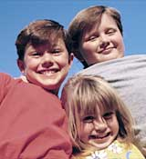
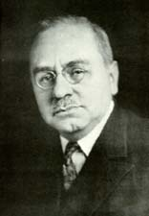
Birth order...
First born:
Perfectionistic
Reliable
Well-organized
Hard driving
Critical
Natural Leader
Middle child:
Mediator
Avoids conflict
Independent
Diplomatic
Loyal
Has many friends
Baby:
Charming
Attention-seeker
Affectionate
People person
Manipulative
Determined/stubborn
1870 - 1937
Austrian psychologist Alfred Adler, theorized on the personality influences attributed to birth order. These characteristics would be developed within, and as the result of the family environment rather than as a inborn temperament.

Slide 9
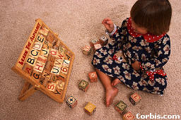
The only child...
Research indicates that only-children may be slightly less affiliative than their peers, belonging to fewer organizations, having fewer friends, and leading a less intense social life. They do, however, have a comparable number of close friends, assume leadership positions in clubs, and feel satisfied and happy with their lives. Parents of an only-child have higher expectations, which may result in higher pressure. Only-children and first-born children demonstrate a less cooperative interactive style than do other children; especially in the area of sharing. They are often described as self-motivated, thorough, adult-like early in life, high achiever, can’t bear to fail, and avid readers. They are rated as highly “likeable” by peers.
Research indicates that only-children have a slight edge over children with siblings on measures of intelligence and achievement--and that they suffer no serious interpersonal deficits. In fact, only-children may have some advantages as a result of their special status: more attention from parents, freedom from sibling rivalry and comparison, and access to more family resources.

Slide 10
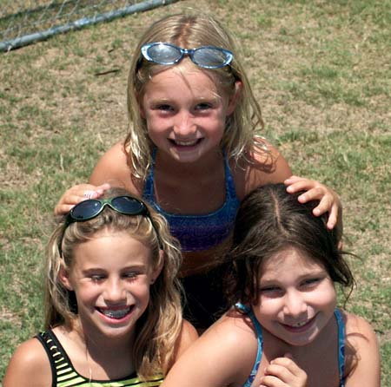
Friendships...
A friendship is a reciprocal commitment between individuals who see themselves more or less as equals. They likely share common interests, display empathy for one another, and have built an intimate relationship.
Friendships are important, and fulfill several functions within the structure of social development:
They are emotional resources, both for having fun and adapting to stress.
They are cognitive resources for problem-solving and knowledge acquisition. PEER TUTORING - the transmission of information from one child to another COOPERATIVE LEARNING - requires children to combine problem-solving contributions and share rewards.
PEER COLLABORATION - occurs when novices work together on tasks that neither can do separately
PEER MODELING refers to one child setting an example and the other imitating that example
Friendships are contexts in which basic social skills such as social communication, cooperation, and group entry skills, are acquired or elaborated
Friendships are forerunners of subsequent relationships

Slide 11
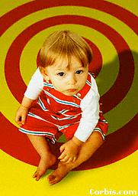
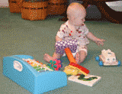
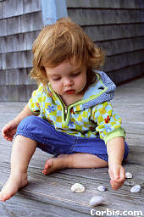
6 Stages of Social Participation...
While 6 different stages of social participation (play) have been identified, only 4 of those can be defined by observable activity. The remaining 2 do not involve movement or interaction.
Stage 1: Solitary Play
Independent play by herself with toys different than what others are playing with

Slide 12
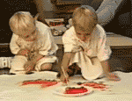
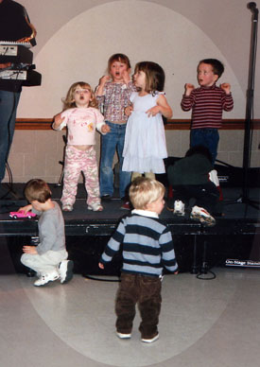
Stage 2: Onlooker
Watching other children, but not interacting with them
Stage 3: Parallel Play
Children are aware of each other’s presence; they are playing beside each other with similar materials, but not with each other

Slide 13
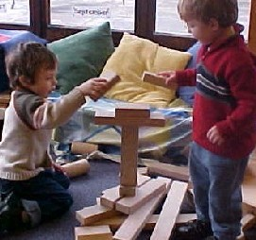
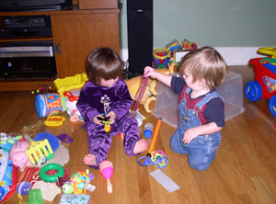
Stage 4: Associative Play
Children are taking turns with each other; interchanging materials
Stage 5: Cooperative Play
All children working toward common goal with some evidence of social organization

Slide 14
SOCIAL DEVELOPMENT

Slide 15
EMOTIONAL DEVELOPMENT

Slide 16
4 Areas of Development...
Human beings develop in 4 different aspects of growth. The areas are all inter-connected, so when one is affected it may influence the others.
Social
Physical
Intellectual
Emotional development involves the recognition and expression of feelings and emotions.
Emotional

Slide 17

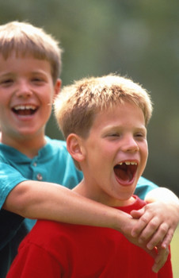
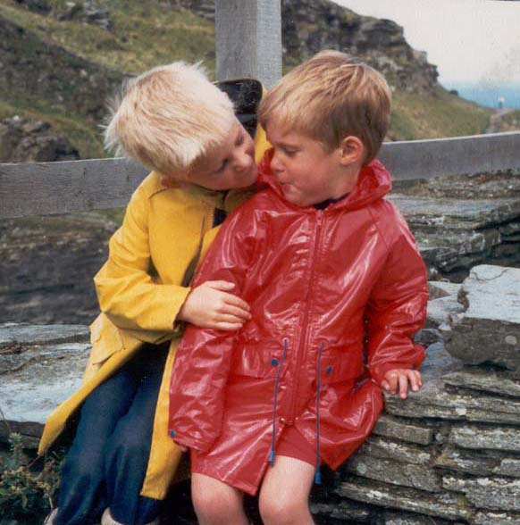

Emotions...
JOY
ANGER
CARING
HATRED
LOVE
Only children know how they feel, and they may not be able to verbally express it; all feelings are valid; children must learn how to control and show feelings; society has expectations of how they should feel and how they should show it
JEALOUSY
HAPPINESS
EMPATHY

Slide 18
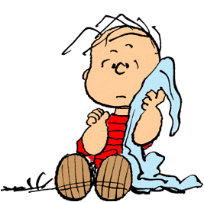
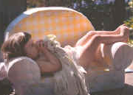
Security blankets...
Security is one of a child’s most basic needs, ranking just above food, water, and shelter. The child who uses the security blanket is balancing the need for security with a desire for independence. The “security friend” is an important way the child has to soothe himself – the way his parents used to soothe him as an infant. With a security friend the child is in control; the child is doing the holding; the “friend” is a source of warmth and comfort.
Children often find the need for a security friend between the ages of 15-18 months. Holding it is often accompanied by other rhythmic movements such as rocking, thumb-sucking, or hair-twirling. The attachment may be temporary, or intense and lasting for years. Most children drop this psychological dependence long before the age of 5.
Research shows no psychological difference in people who had or did not have a security friend during childhood.

Slide 19

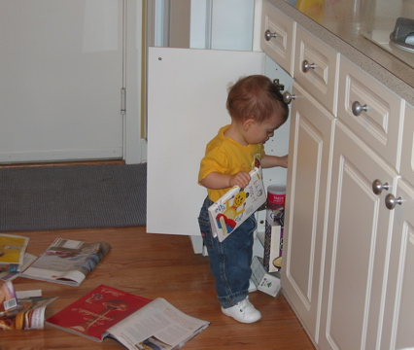
Being naughty...
By the age of 1 year, children recognize the difference between being “good” and being “naughty”. When they know they have been good, they seek a sign of approval. Caregivers can now begin to set limits.
Children naturally test the limits set for them. They may use the word “no”, but continue the unacceptable action anyway. They often do this to fulfill their need for attention. They are not capable of understanding or considerate of another person’s point of view. They are egocentric.

Slide 20
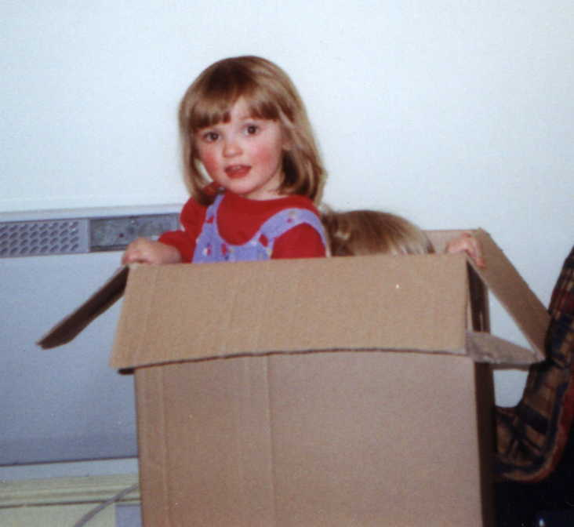
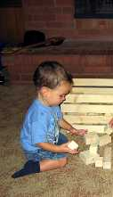
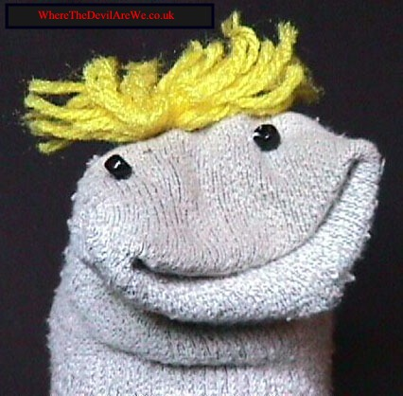
Imagination and creativity...
Using imagination and developing creativity is essential for cognitive, social, and emotional development of children. Creativity is essential for problem-solving.
Symbolic representation: using an object or symbol to represent something else. This is not a sock; it’s a talking creature. This is not a cardboard box, it is an airplane; it’s not a bunch of wooden blocks, they are wild horses.
In order to foster imagination and creativity, adults should allow preschoolers unstructured time for child- directed play and provide a variety of materials. This will help children realize their creative potential, instill a love for learning and develop an internal motivation for completing tasks.

Slide 21
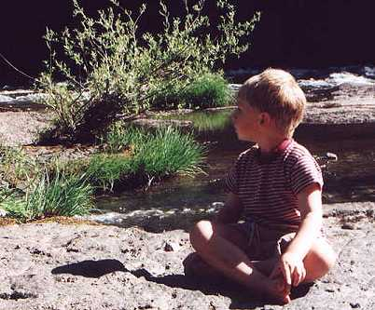
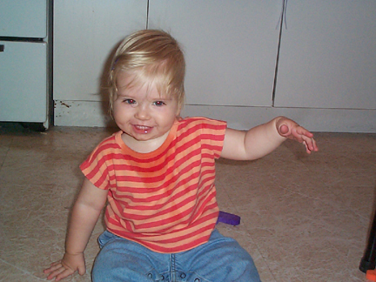
Imaginary friends...
"Imagination is more important than knowledge.
For knowledge is limited to all we now know and understand, while imagination embraces the entire world, and all there ever will be to know and understand."
-ALBERT EINSTEIN
Imaginary friends are created in the minds of children for the purpose of companionship, play, as a scapegoat, someone who consoles, a protector, an extra conscience, or as a way of coping with stress. They show up at around 3 years of age and usually disappear in early elementary school. Having an imaginary friend is rarely a sign of emotional problems, but is simply one form of creativity.

Slide 22

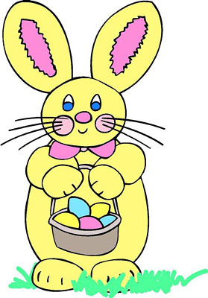
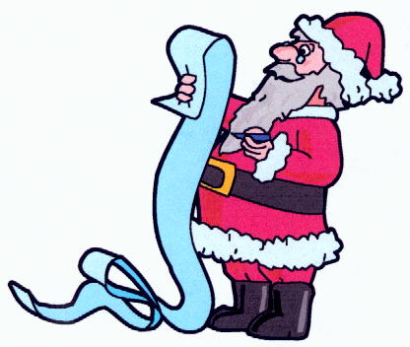
Childhood myths...
The Tooth Fairy, Santa Claus, and the Easter Bunny are examples of folklore mythology which adults know are fiction, but which is sometimes presented to children as fact. Although some parents consider the promotion of such myths as outright lies to their children, who may challenge their credibility at some later date, the psychological community in general does not consider it harmful. Some families participate in the roles of these myths long after the child has discovered the fiction as a form of play or tradition.
There may be some good purposes in promoting childhood myths. The tooth fairy encourages children to look forward to the loss of a tooth, rather than to fear the process. It gives children a reason to give up a part of themselves that they may have grown attached to. They also develop a sense of faith in things unseen, and may help them understand the difference between “real” and “imaginary”.

Slide 23
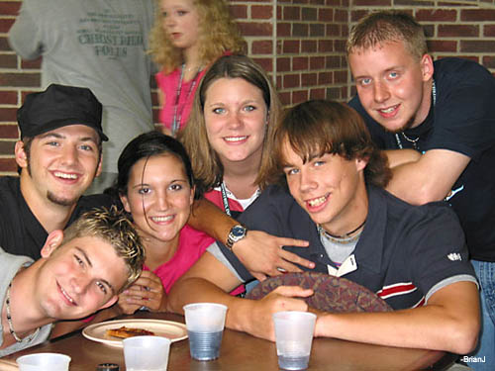
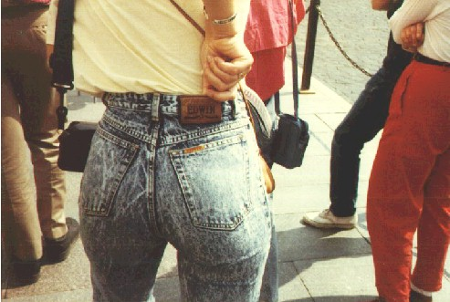
Conformity...
In order to live within a society, a child must be able to follow certain standards and regulations. This is conformity.
Conformity also provides an opportunity for “belonging”, which is critical for self-esteem.
Children use conformity, however, as they strive for greater independence from the parent. Nearing adolescence, the child begins to conform to their friends ideas, separating themselves from their parent’s ideas. They like the same music groups, movies, manner of dress and speech, activities, and video games as their friends. Eventually the child will begin to express their own individuality. If parents overreact, children get defensive.

Slide 24

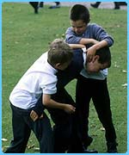
Stress can be positive or negative. It can be a reaction to an exciting or important event such as a major test or big sporting event. This kind of stress, within limits, is positive and can help challenge a person to do their best.
Stress...
Some stress is negative, distress, and can cause feelings of fear, hopelessness, worry, anxiety, and doubt. Mild or moderate levels of distress are normal, and needed to teach children coping skills. Intense feelings of distress can interfere with a person’s ability to function normally.
Common causes of stress in children include conflicts with others, poor health or unhealthy habits, having an overly-full schedule, major life changes such as divorce, death, or moving.

Slide 25

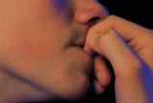
The brain releases stress hormones , one of which is called cortisol.
Symptoms of stress...
A child under stress may exhibit one or more signs:
Loss of interest in previously enjoyed activities
Explosive crying or screaming
Verbal or physical aggressiveness
Cruelty to pets and playmates
Physical symptoms such as rapid heartbeat, headaches, fatigue, restlessness, upset stomach or neck pain
Loss of humor or sense of joy
Nightmares, sleep-walking, or teeth-grinding
Hair twisting, nail biting, stuttering, excessive fidgeting
Threats to harm someone or destroy property
Immersion in computer, e-mail, or TV
Jumpiness or fear of sudden sounds

Slide 26
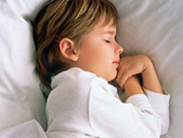
Nightmares are bad dreams, starting between the ages of 3 and 6, and affecting 10 to 50 percent of children. They tend to increase when children are under stress, especially after traumatic experiences, and may reflect how a child views the events of the day. Nightmares tend to occur a few hours before a child awakes, when dreaming is more intense. When awakened by bad dreams, children can often remember some details and may want to talk about them. When you comfort a child during a nightmare, he or she will most likely respond well to your reassurance.
Dreaming...
Dreams are a sequence of images that appear involuntarily while sleeping; often a mixture of real and imaginary characters, places, and events. All human beings dream.
A night terror usually occurs just a few hours after a child falls asleep. He may sit up, struggle, moan, talk or scream. His heart may race and he may sweat. The event can last anywhere from 10 to 30 minutes. The child may not be aware of the parent’s presence, and the child will probably have no memory of waking up at all.

Slide 27
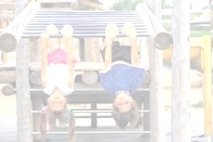
Physical and Motor Development
Sukla Dutta

Slide 28
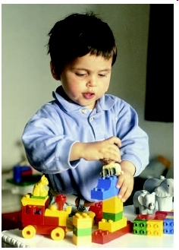
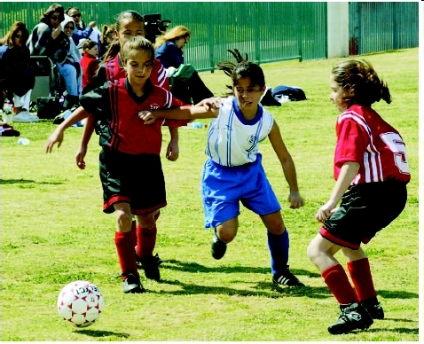
What is Motor Development?
The development of action and
coordination of one’s limbs.
The development of strength,
posture control, balance and
perceptual skills.

Slide 29
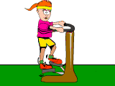
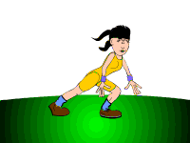
Principles of Motor Development
Neural and muscular maturation
Readiness of the child
Predictable pattern
Individual differences

Slide 30
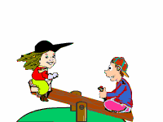
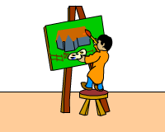
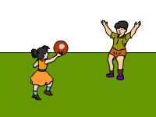
What Influences Motor Development ?
Maturation
- From central to peripheral
- From head to toe
Environment
- Growth, strength, nutrition
- Motivation
Practice
- New skills build on prior abilities
- Motor pathways are refined through use

Slide 31
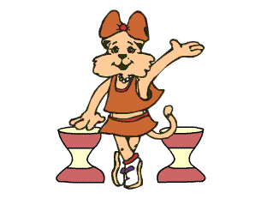
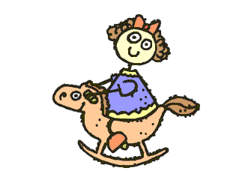
How will these promote other skills ?
Activities that require good control over the whole
body are useful for ‘gymnastic’ skills later
Activities that require strength and speed help in
sports skills and games
Activities emphasizing rhythm lead to skills in dancing

Slide 32
MOTOR COORDINATION
Gross Motor Skills
Fine Motor Skills

Slide 33
Gross Motor Skills

Slide 34
Gross Motor Milestones
(2 – 5 Years of Age) : GROSS MOTOR BEHAVIOUR
48 months :
May ascend a ladder by leading with alternate feet. Broad jumps approximately 0.61 metre. Balances on one foot for 8 seconds. Is able to hop on one foot. Catches objects that have been thrown. Jumps in place with two feet.
52 months :
Displays highly synchronous walking. Descends stairs by leading with alternate feet.
56 months :
Descends ladder by leading with alternate feet. Is able to hop seven or more steps on one foot. Throws 0.08 metre ball 3.05 metre.
5 years :
Is beginning to skip. Walks backward heel to toe. Walks like an adult. Gallops. Hops 10 or more steps on one foot. Throws a 0.23 metre ball approximately 3.05 metre.

Slide 35
Instructional Objectives
It refines a child’s gross motor( large muscle ) skills.
Body awareness – for improved posture and control crossing the mid-line-laterity, i.e., awareness of the left and right sides of the body
The child also encounters objects in nature or something which captivates his or her attention
The child develops the ability to maintain equilibrium
Major muscle coordination – spatial orientation – awareness of body position in space and in relation to other object and people
Acquires vocabulary during activities like backward, forward, sideways, etc.

Slide 36
Development of
Fine Motor Skills

Slide 37
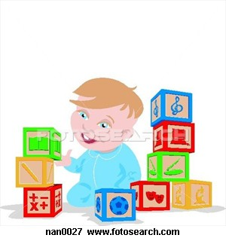
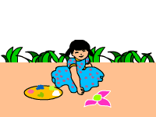
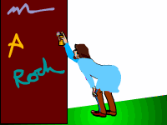
What are Fine Motor Skills
Developing control over the movement of finer muscles in particular the finger and wrist muscles
Developing hand-eye coordination

Slide 38

Hierarchy and Progression of Typical Fine Motor Development

Slide 39
Instructional Objectives
Ocular Motor Control – The ability of the eyes to follow and focus on an object in the field of vision as required.
Hand – Eye Coordination – The ability to execute activities with the hands, guided by the eyes requiring accuracy in placement, direction and spatial awareness
Foot-Eye Coordination – The ability to execute action with the feet, guided by the eyes
Manual Dexterity – The ability to accurately manipulate the hands and fingers for neat handwriting, drawing, typing skills, etc.

Slide 40
Hand Development Milestones
Development of arches in hand
Development of wrist extension that supports skilled finger movements
Development of an awareness of the – “skill” side of the hand
Development of an open index finger –thumb web space – O
Development of skill in the small muscles contained in the hand

Slide 41

Developmental Objectives attained from
Fine Motor Skills
Improves hand-eye coordination
Improves foot-eye coordination
Increases observation power
Enhances finger muscle development
Fosters creative expression
Enhances the ability to recognize unseen objects using
the sense of touch

